Slide 1


MEET ANDRE

Slide 2
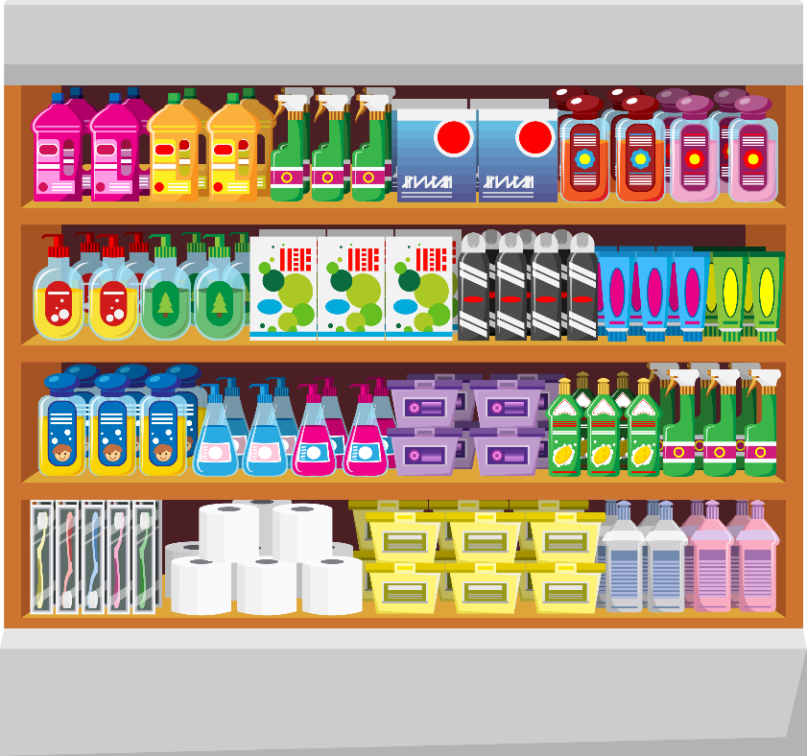

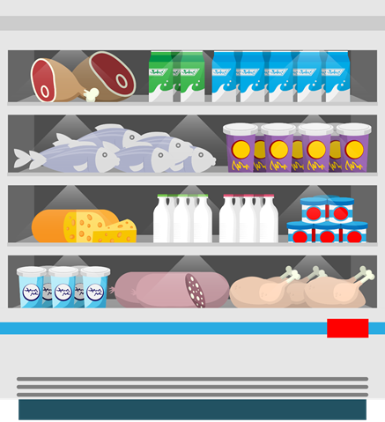
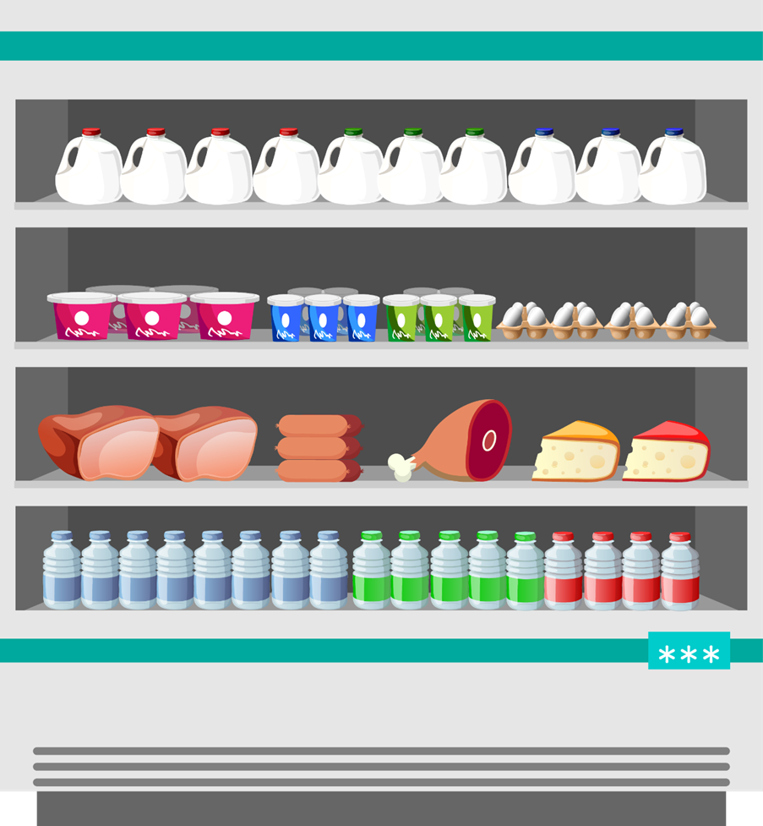
TIMER
ANDRE is a local business owner

Slide 3

TIMER
HE SPENT LOGN HOUR WORKING EVERIDAY

Slide 4

TIMER
BUT HIS INCOME STILL LOW…..

Slide 5

TIMER
HE NEED SOMETHING
TO TAKE HIS BUSINESS TO ANOTHER LEVEL

Slide 6


TIMER
UNTIL HE FOUND
PRODUCT
BOX SAMPLE
Internet marketing booster
LOGO HERE
IM BOOSTER

Slide 7
TIMER
PRODUCT BENEFIT
PRODUCT
BOX SAMPLE
SEO CONTENT MANAGEMENT SYSTEM
Internet marketing booster
HIGH CONVERSION RATE OPTIMISATION
INCREASE SELLING LIMITS
OPTIMISATION BUSINESS GROWTH
INCREASE YOUR INCOME AND SAVE MORE MONEY
LOGO HERE
IM BOOSTER

Slide 8

TIMER
SO NOW
ANDRE
CAN BE HAPPY

Slide 9
TIMER
BECAUSE HE HAS FULL CONTROL OVER HIS CAMPAIGNS

Slide 10
TIMER
SO ARE YOU READY
TO GROW YOUR BUSINESS
LIKE ANDRE ?

Slide 11
TIMER
GRAB
IM BOOSTER NOW

Slide 12
TIMER
www.yourdomain.com
mail@yourdomain.com
Your name
#Your name
Your name

